Slide 1


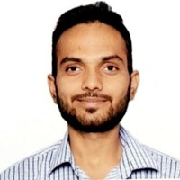

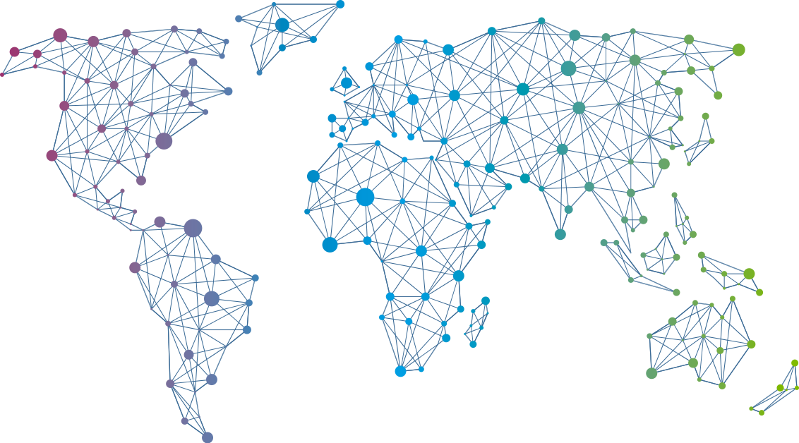

Speaker
Nitish Sharma
Application containerization and deployment
Nitish Sharma
September 16th & 17th
^{Online Event}
Powered By
International Conference

